Slide 1
Development Methodologies
CTEC 295

Slide 2
What’s the Point?

Slide 3
Business Land
Deadlines
Deliverables
Structure
You aren’t just completing steps, you’re completing, documenting and archiving phases.

Slide 4
Why All the Red Tape?
Responsibility
“Who signed off on this!?”
Organization
Reliability

Slide 5
Dev Methodology Benefits
Provide a concrete, tested structure for development
Allow better time-table estimation
Determines criteria for success or failure
Determines criteria for when each part is done
Improve communication

Slide 6
Choosing a Methodology

Slide 7
Requirements of a Dev Methodology
Process Contains:
Software Specification
Software Design and Implementation
Software Verification and Validation
Software Evolution
Each Step Involves:
Products / Deliverables
Roles
Pre-Condition
Post-Condition

Slide 8
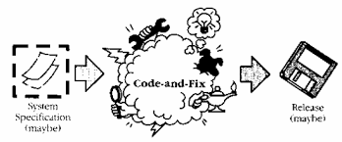
Code-And-Fix
An Anti-Pattern
Steps:
Write up a small document on what you want to build (optional)
Start coding
Fix errors
Stop when it looks done

Slide 9
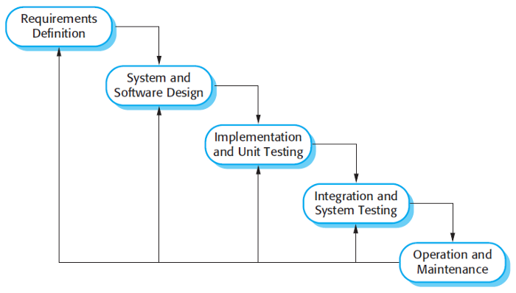
Waterfall

Slide 10
Wait, What’s the Difference?
Methodologies are about structure
Code-And-Fix has vague / non-existent design and review steps
Waterfall steps are clearly defined and generally each have their own deliverable

Slide 11
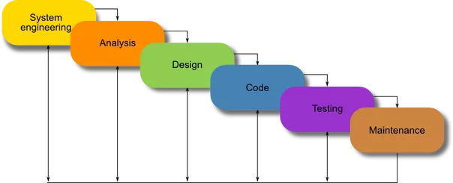
An Alternative Waterfall...

Slide 12
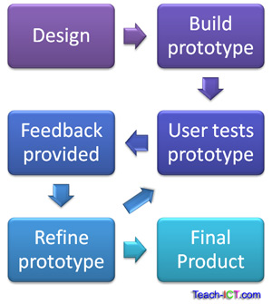
Evolutionary Prototyping

Slide 13
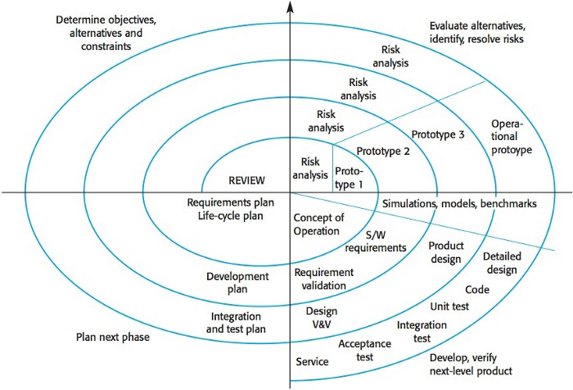
Spiral

Slide 14
Spiral - Steps Un-spiralized
Determine Objectives, Alternatives and Constraints
Identify and Resolve Risks
Evaluate Alternatives
Develop the deliverables for that iteration, and verify that they are correct
Plan the next iteration
Commit to an approach for the next iteration if one is needed

Slide 15
Spiral - What’s a Risk?
Poorly Understood Requirements
Poorly Understood Architecture
Potential Performance Problems
Problems in Underlying Technology
Something you’re unsure of and need to test

Slide 16
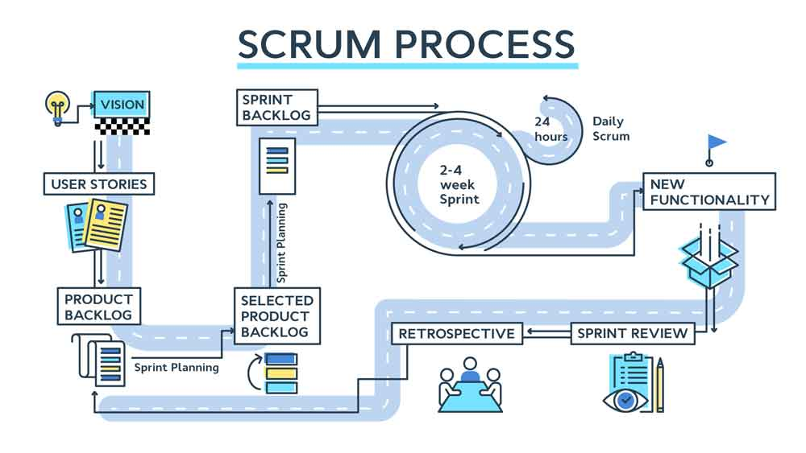
Scrum

Slide 17
Scrum Roles
Product Owner - Helps the team understand the User’s needs
Scrum Master - Helps the team understand and execute Scrum
Not necessarily in-charge
Development Team

Slide 18
The Backlog
Each item should note:
Order
Description
Estimate
Value
As long as the project is running, the Backlog can change

Slide 19
Sprints
Occur on Regular Intervals
Sprint Goal - what are we trying to do in general?
Sprint Backlog - which items will fulfill the goal?
Tasks - what will implement each Backlog item?
Sprint Review - what did we get done?
Sprint Retrospective - what can we change to work better for the next sprint?

Slide 20

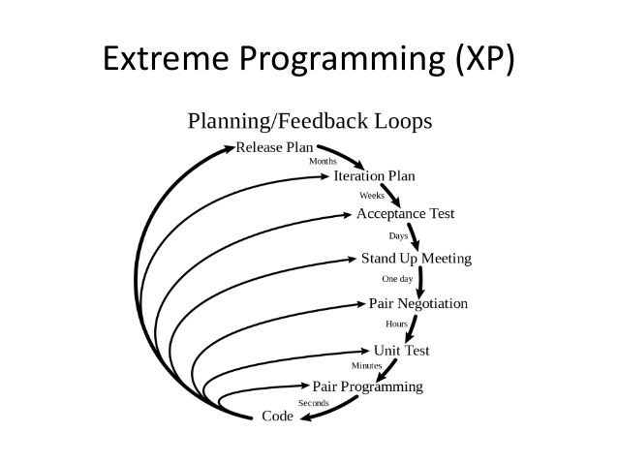
Extreme Programming

Slide 21
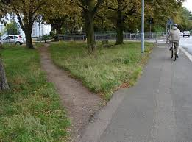
A Methodology is Not a Straight-Jacket
If it ain’t working, change it
Try to review what does work and what doesn’t
If you’re not working precisely within the structure, it’s not necessarily a problem

Slide 22
Agile

Slide 23
The 12 Agile Principles
Early and Continuous Delivery
Embrace Changing Requirements
Deliver Working Software Frequently
Business People and Developers Must Work Together
Build around Motivated Individuals
Face-to-Face conversation
Working Software is the Primary Measure of Progress
Sustainable Development
Attention to Technical Excellence
Simplicity - Maximize Amount of Work Not Done
Self-Organization
Scheduled Self-Reflection

Slide 24
The Agile Methodology
… does not exist
Scrumm and Extreme Programming are considered Agile

Slide 25
Common Tools of Agile
User Stories
Backlog
Iterations
Test-Driven Development
Stand-Up Meetings

Slide 26
Project Management Tools

Slide 27
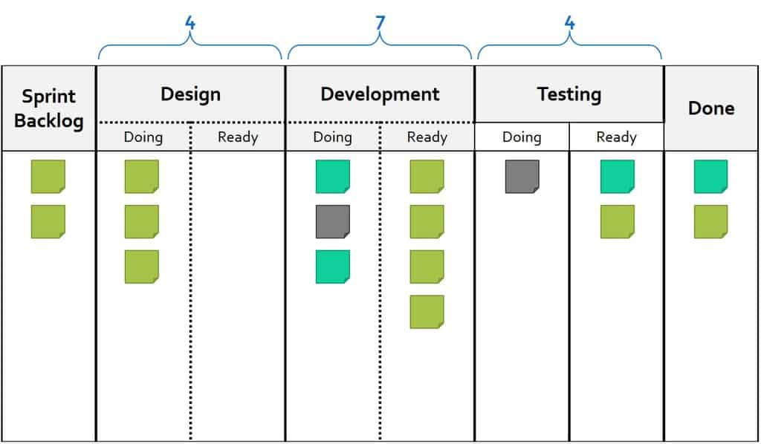
Kanban

Slide 28
Tools that Implement Kanban Practices
https://trello.com/
https://www.pivotaltracker.com/

